Slide 1


http://pingo.edu.vn/khoa-hoc-php-can-ban/
PHP Basics – Cookies - Sessions
Web Applications in Hatch
Tuan Duong
http://pingo.edu.vn/tuan-duong/

Slide 2
Contents
Introduction
Cookies
Sessions

Slide 3
Maintaining State in PHP
xHTML – a “stateless” environment
Stateless: Having no information about what occurred previously.
Most modern applications maintain state, which means that they remember what you were doing last time you ran the application, and they remember all your configuration settings. This is extremely useful because it means you can mould the application to your working habits.
Each request for a new web page is processed without any knowledge of previous pages requested or processed.

Slide 4
How do they do that
For example
A user “logs in” to a web page. Once logged in, the user can browse the site while maintaining their logged in state.

Slide 5
Is PHP stateless
Variables are destroyed as soon as the page script finishes executing.
The script can access the ‘referrer’, the address of the previous page, although it can’t really be trusted.
$_SERVER['HTTP_REFERER']
It is possible to add data to a database/text file to add persistent data, although this is not connected with a particular user.

Slide 6

Is PHP stateless… No!
The usual way to maintain state in PHP pages is via the use of Sessions.
To understand how these work, we need to have a look at what and how Cookies are

Slide 7
Cookies
What is a Cookie?
A cookie is a small text file that is stored on a user’s computer.
Each cookie on the user’s computer is connected to a particular domain.
Each cookie be used to store up to 4KB of data.
A maximum of 20 cookies can be stored on a user’s PC per domain

Slide 8
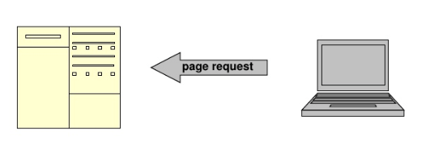
Cookies - Example
User sends a request for page at www.example.com for the first time

Slide 9
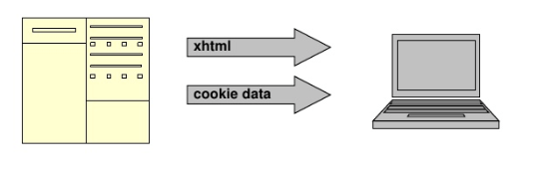
Cookies - Example
2. Server sends back the page xhtml to browser AND stores some data in a cookie on the user’s PC

Slide 10
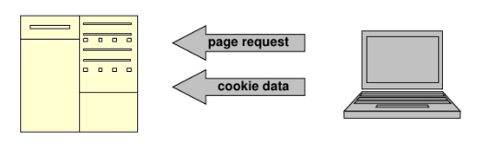
Cookies - Example
3. At the net page request for domain www.example.com, all cookie data associated with this domain is sent too.

Slide 11
Set a cookie
setcookie(string $name [, string $value [, int $expire = 0 [, string $path [, string $domain [, bool $secure = false [, bool $httponly = false ]]]]]])
name: cookie name (string)
value: The value of the cookie. This value is stored on the clients computer; do not store sensitive information. Assuming the name is 'cookiename', this value is retrieved through $_COOKIE['cookiename']
expire: UNIX timestamp when the cookie expires. Default is that cookie expires when browser is closed. Ex: time()+3600 will set the cookie to expire in 1 hour.

Slide 12
Set a cookie
setcookie(string $name [, string $value [, int $expire = 0 [, string $path [, string $domain [, bool $secure = false [, bool $httponly = false ]]]]]])
path: Path on the server in which the cookie is available on. If set to '/', the cookie will be available within the entire domain. If set to '/foo/', the cookie will only be available within the /foo/ directory and all sub-directories such as /foo/bar/ of domain. The default value is the current directory that the cookie is being set in.
domain: Domain at which the cookie is available for.
secure: If cookie should be sent over HTTPS connection only. Default is false.
httponly: When TRUE the cookie will be made accessible only through the HTTP protocol

Slide 13
Set a cookie - examples
setcookie('name', 'Chris');
This command will set the cookie called name on the user’s PC containing the data Chris. It will be available to all pages in the same directory or subdirectory of the page that set it (the default path and domain). It will expire and be deleted when the browser is closed (default expire).
setcookie('age', '20', time() + 60 * 60 * 24 * 30);
This command will set the cookie called age on the user’s PC containing the data 20. It will be available to all pages in the same directory or subdirectory of the page that set it (the default path and domain). It will expire and be deleted after 30 days.
setcookie('gender', 'male', 0, '/');
This command will set the cookie called gender on the user’s PC containing the data male. It will be available within the entire domain that set it. It will expire and be deleted when the browser is closed.

Slide 14
Read cookie data
All cookie data is available through the superglobal $_COOKIE
$variable = $_COOKIE['cookie_name'];
Example
$age = $_COOKIE['age'];

Slide 15
Storing an array
Only strings can be stored in Cookie.
To store an array in a cookie, convert it to a string by using serialize() PHP function.
The array can be reconstructed using unserialize() function once it had been read back in.
Remember cookie size is limited.

Slide 16
Delete a cookie
To remove a cookie, simply overwrite the cookie with a new one with an expiry time in the past
setcookie('cookie_name', '', time() - 5000);
Note that theoretically any number taken away from the time() function should do, but due to variations in local computer times, it is advisable to use a day or two.

Slide 17
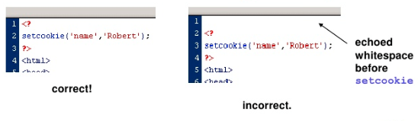
To be first: HEADER REQUESTS
As the setcookie command involves sending a HTTP header request, it must be executed before any xHtml is echoed to be the browse, including whitespaces

Slide 18
Notes
The important thing to note is that some people browse with them turned off.
In FF: Tools > Options > Privacy
Cookies are stored client-side, so never trust them completely: They can be easily viewer, modified or created by a 3rd party.

Slide 19
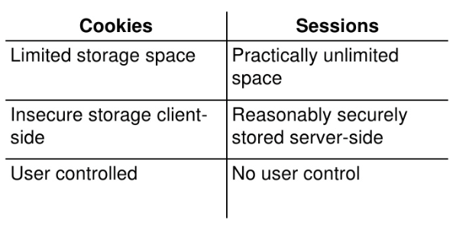
Sessions

Slide 20
How do Sessions work?
They are based on assigning each user a unique number, or session id.
Eg: 0cc175b9c0f1b6a831c399e269772661
This session id is stored in a cookie, or passed in the URL between pages while the user browses.
The data to be stored (ex: name, log-in state, etc…) is stored securely sever-side in a PHP superglobal, and referenced using the session id

Slide 21
How do Sessions work?
Crucially, sessions are easy to implement as PHP does all the work!

Slide 22
Starting or Resuming a Session
session_start();
PHP does all the work: It looks for a valid session id in the $_COOKE or $_GET superglobals – if found it initializes the data. If none found, a new session id is created. Note that like setcookie(), this function must be called before any echoed output to browser.
When doing anything with sessions, this is always called first!

Slide 23
Storing Session Data
The $_SESSION superglobal array can be used to store any session data
<?php
$name = "Chris";
$age = "20";
$_SESSION['name'] = $name;
$_SESSION[‘age'] = $age;
?>

Slide 24
Reading Session Data
Data is simply read back from $_SESSION superglobal array
<?php
$name = $_SESSION['name'];
$age = $_SESSION[’age'];
?>

Slide 25
Session Propagation
Sessions need to pass the session id between pages as a user browses to track the session.
It can do this in two ways
Cookie propagation
URL propagation

Slide 26
Cookie Propagation
A cookie is stored on the users PC containing the session id.
It’s read in whenever session_start(); is called to initialize the session.
Default behaviour is a cookie that expires when the browser is closed. Cookie properties can be modified with session_set_cookie_params if required.

Slide 27
URL Propagation
The session id is propagated in the URL
http://example.com/some_folders/index.php?sid=0cc175b9c0f1b6a831c399e269772661
PHP provides a global constant to append the session id to any internal links: SID
<a href="nextpage.php?<?php echo SID;?>">Next page</a>

Slide 28
Which one?
The default setup of a PHP server is to use both methods.
It checks whether the user has cookies enabled.
If cookies are on, PHP uses cookie propagation. If cookies are off it uses URL propagation.
That as developers, we must be aware that sessions can be propagated through URL, and append the constant SID to any internal links.
If sessions are being propagated by cookies, the constant SID is an empty string, so the session id is not passed twice.

Slide 29
Destroying a Session
Often not required, but if we want to destroy a session
<?php
session_start();
// Clear all session variables
$_SESSION = array();
// Delete the session cookie if there is one
// Get session name stored in cookie (the variable holds session id value)
$sessionName = session_name();
if (isset($_COOKIE[$sessionName])) {
setcookie($sessionName, '', time() - 50000, '/');
}
// Destroy session
session_destroy();
?>

Slide 30
Session Expiry
By default, PHP sessions expire:
After a certain length of inactivity (default 1440s, configurable via php.ini), the PHP garbage collection processes deletes session variables.
If propagated by cookies, default is to set a cookie that is destroyed when the browser is closed.
If URL propagated, session id is lost as soon as navigate away from the site.

Slide 31
PHP Basics - Strings

